Slide 1

Designer | Team Leader | Director | CEO
Team 1 | Team 2 | Team 3 | Team 4
DermoBella Skin 2
Android V1.9.1
- CONFIDENTIAL -

Slide 2

Menu Tree (Wireframe)
Device Activation
Device Pairing (AP)
Device Pairing ( AP )
Login / Registration
SETTINGS
Analysis
EXPERT Analysis
General Settings
Full Face Analysis
Skin Sensitivity
Camera Settings
Moisture / Sebum
Skin Tone
Language Settings
Pores
Questionnaires
Product Recommendation
Spots
Results
Send Images
Wrinkles
Share
Backup Copies
Impurities
Share/Email
Keratin
CONFIDENTIAL Copyright © 2018 Chowis Co. Ltd.

Slide 3
History
Version | Date | Writer | Description
1.7.1 | 30-NOV-2020 | Kim Bryan P. | *Added New Connection Scenario *New icon for Mobile Data and Wi-Fi router
1.7.2 | 09-DEC-2020 | Kim Bryan P. | *Made 2 options for Using Mobile Data when pressing Analyze *Added UI for QR code scan both device and paper *Added Analyze and Cancel buttons in the Analysis Results Review *Added Skin Sensitivity Measurement
1.7.7 | 16-DEC-2020 | Kim Bryan P. | *Made 2 options for Using Mobile Data when pressing Analyze *Added UI for QR code scan both device and paper *Added Analyze and Cancel buttons in the Analysis Results Review *Added Skin Sensitivity Measurement
1.7.9A |  | Kim Bryan P. | *W-Fi Frequency *Sleep Mode Timer *CRM – Sync Data and Download Images
1.7.9B |  | Kim Bryan P. | *OTP – License
1.8.0 |  | Kim Bryan P. | *Modified Connection Scenario *Skin Sensitivity
1.8.1 | 19-JAN-2020 | Kim Bryan P. | *Registration with Email Verification *Forgot Password *Update Privacy Policy *New Login Scenario
1.8.2 | 31-MAR-2021 | Kim Bryan P. | *Update User Profile Page *Update User Registration Page
1.8.3 | 26-MAY-2021 | Kim Bryan P. | *Skin Sensitivity *Questionnaire
1.8.4 | 15-JUNE-2021 | Kim Bryan P. | *Added Web Result
1.8.5 | 24-JUNE-2021 | Kim Bryan P. | *Added Skin Health Questionnaire *Update FFA New Guidelines

Slide 4
History
Version | Date | Writer | Description
1.8.6 | 12-AUG-2021 | Kim Bryan P. | *Update Questionnaire Skin Sensitivity and Skin Health
1.8.7 | 14-SEPT-2021 | Kim | *Added Share link via KakaoTalk
1.8.8 | 06-OCT-2021 | Kim | *Added Skin Tone Measurement *Update Share Results scenario
1.8.9 | 06-OCT-2021 | Kim | *Added example in Sharing results via KakaoTalk
1.9.0 | 08-OCT-2021 | KIM | *Average per age group
1.9.1 | 25-NOV-2021 | KIM | *FFA Results Review

Slide 5
Page Story Board

Slide 6
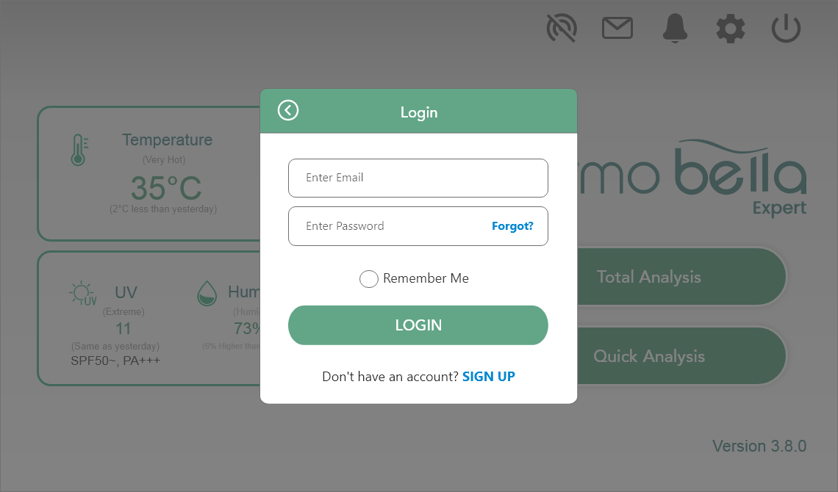
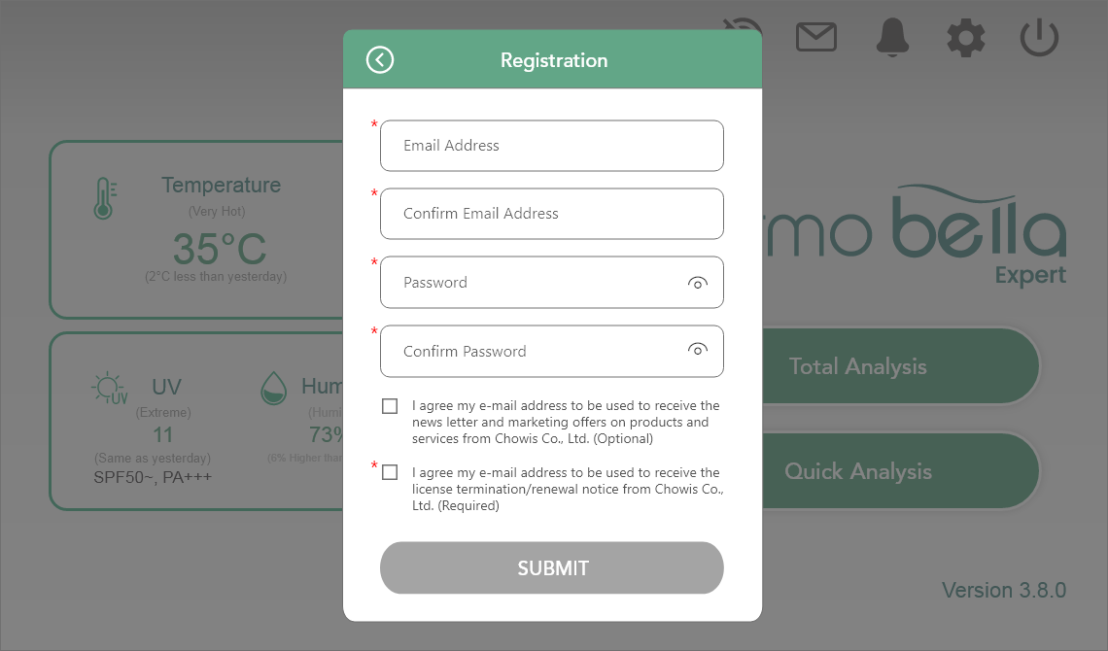
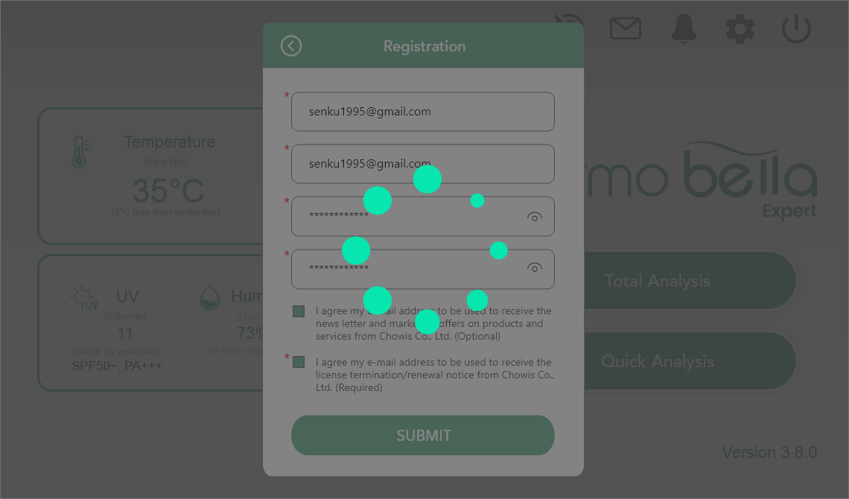
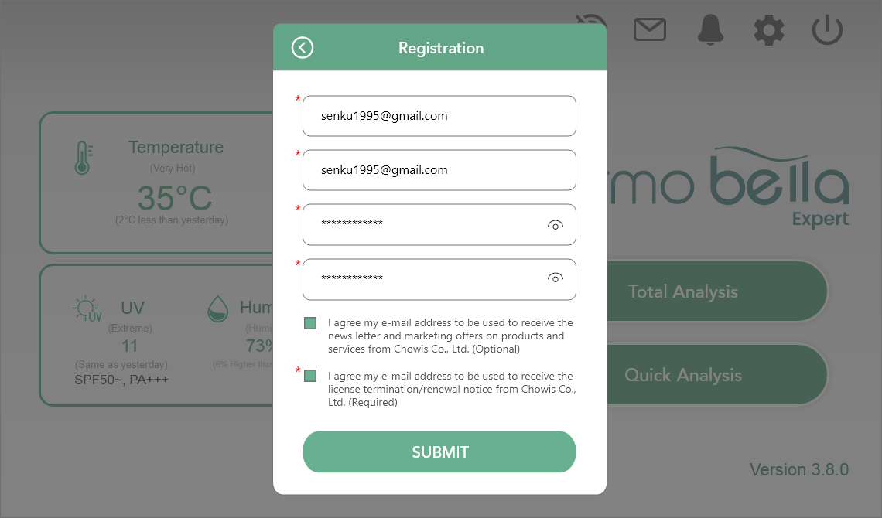
Registration

Slide 7
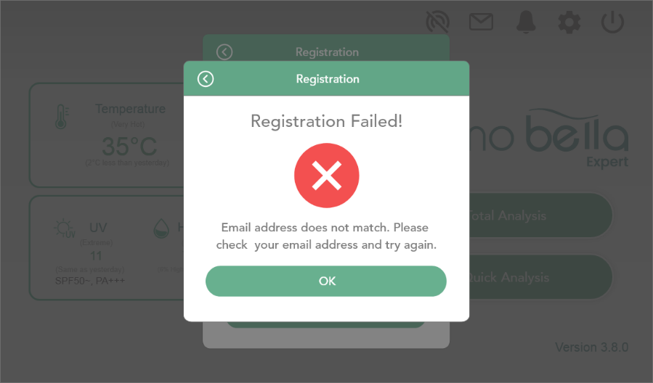
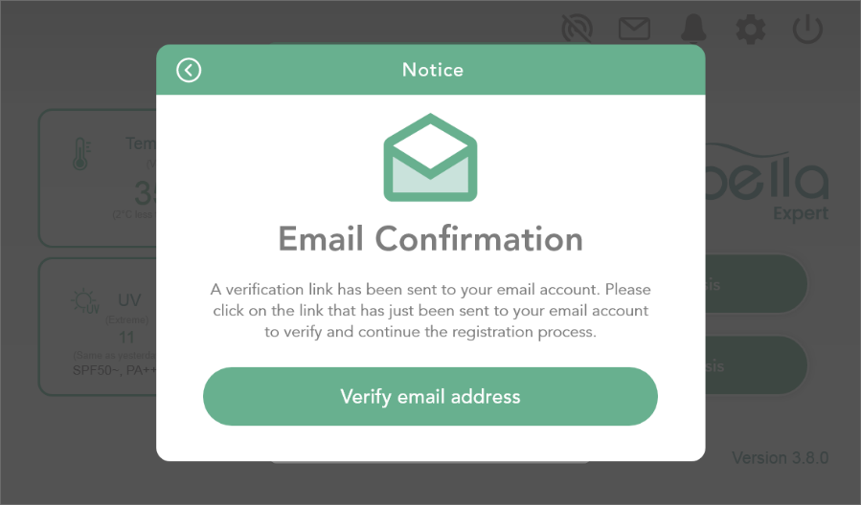
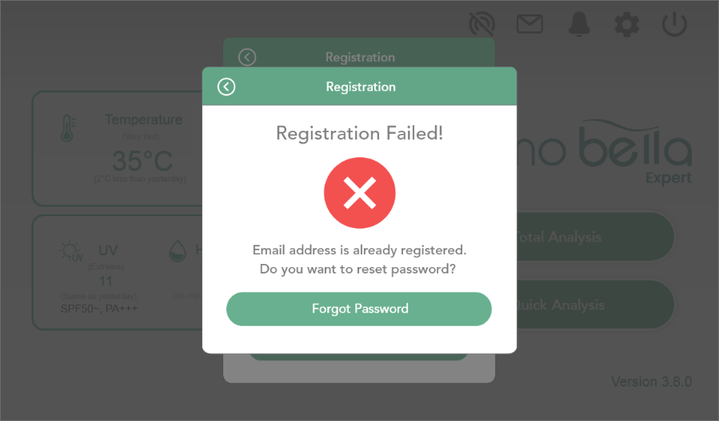
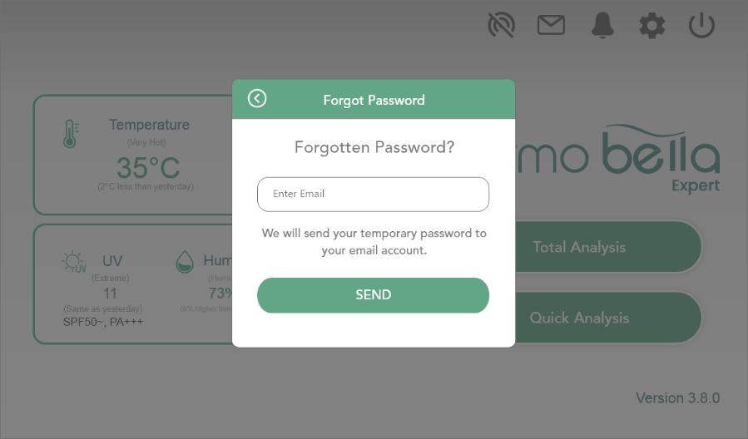
If Email Address does not match
If Email Address is already registered

Slide 8
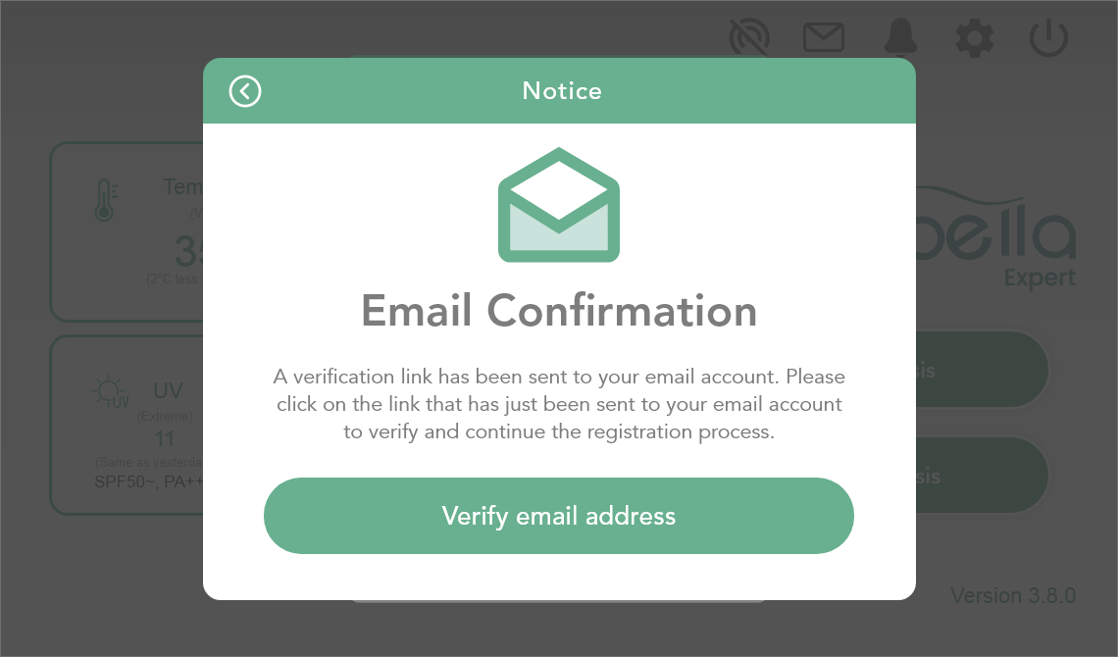
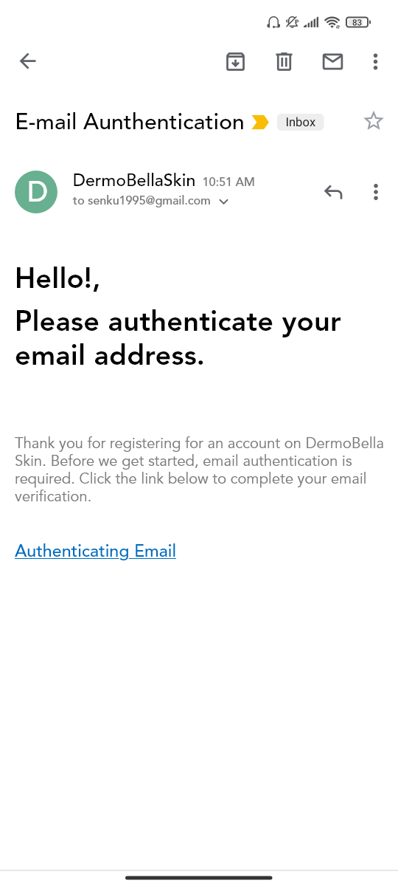
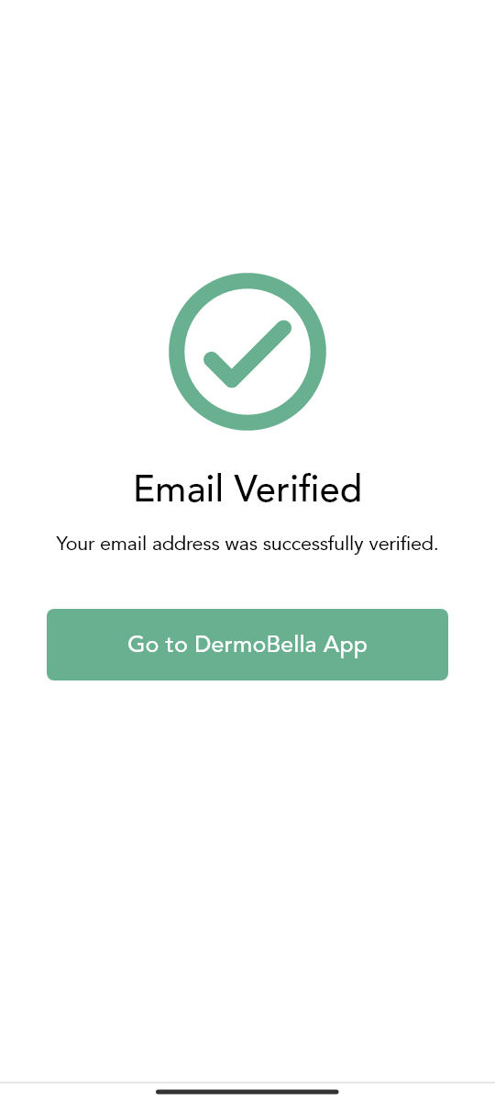
VERIFY EMAIL ADDRESS
Sending via email from server

Slide 9
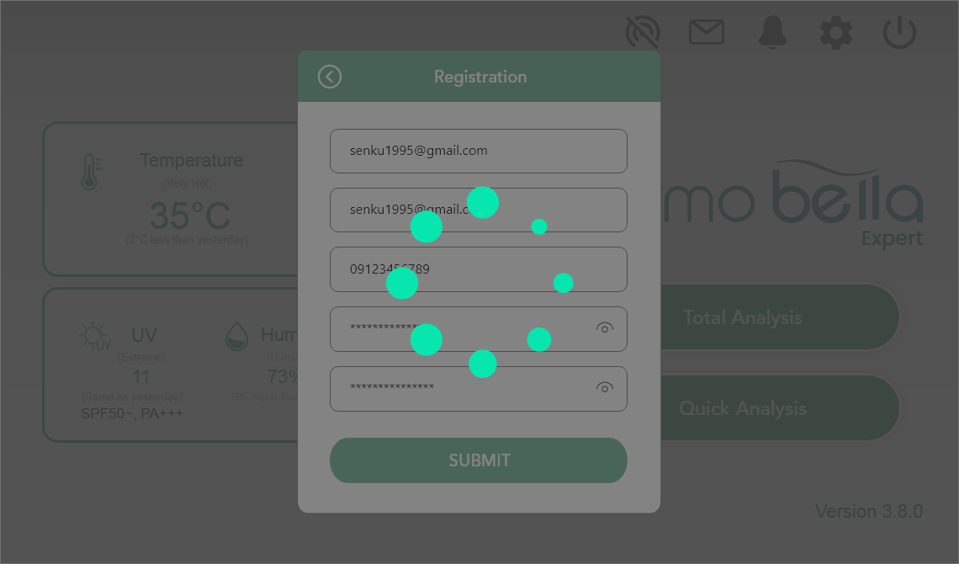
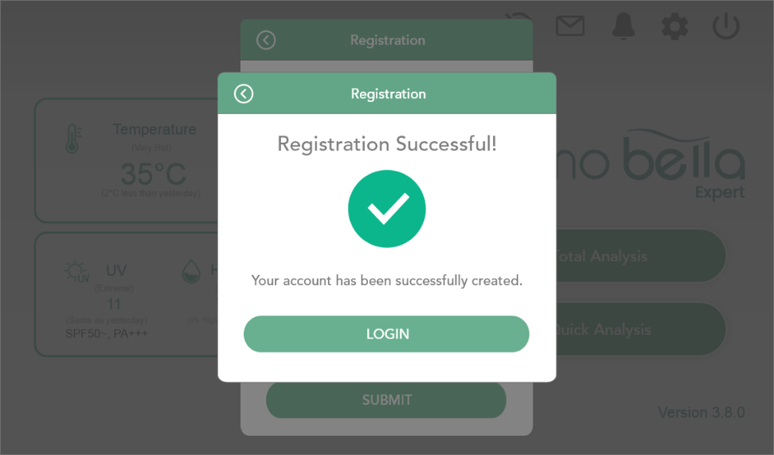


Slide 10
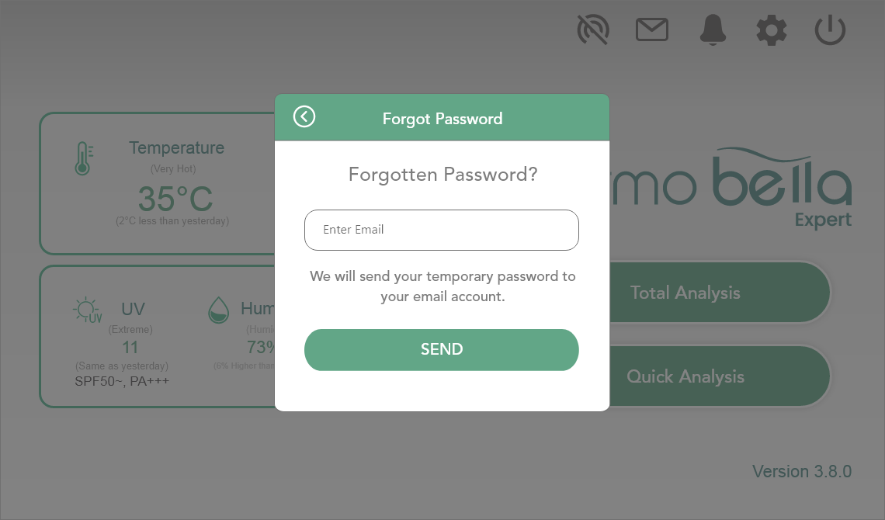
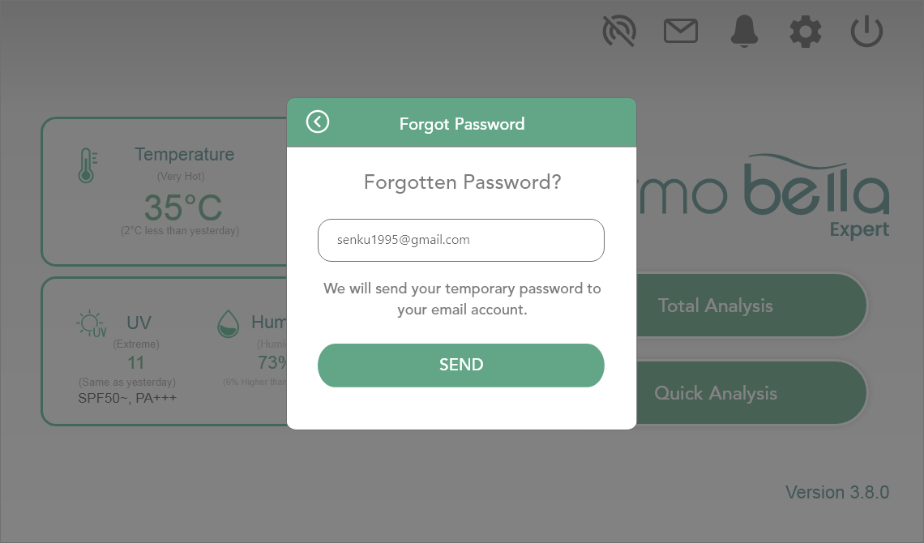
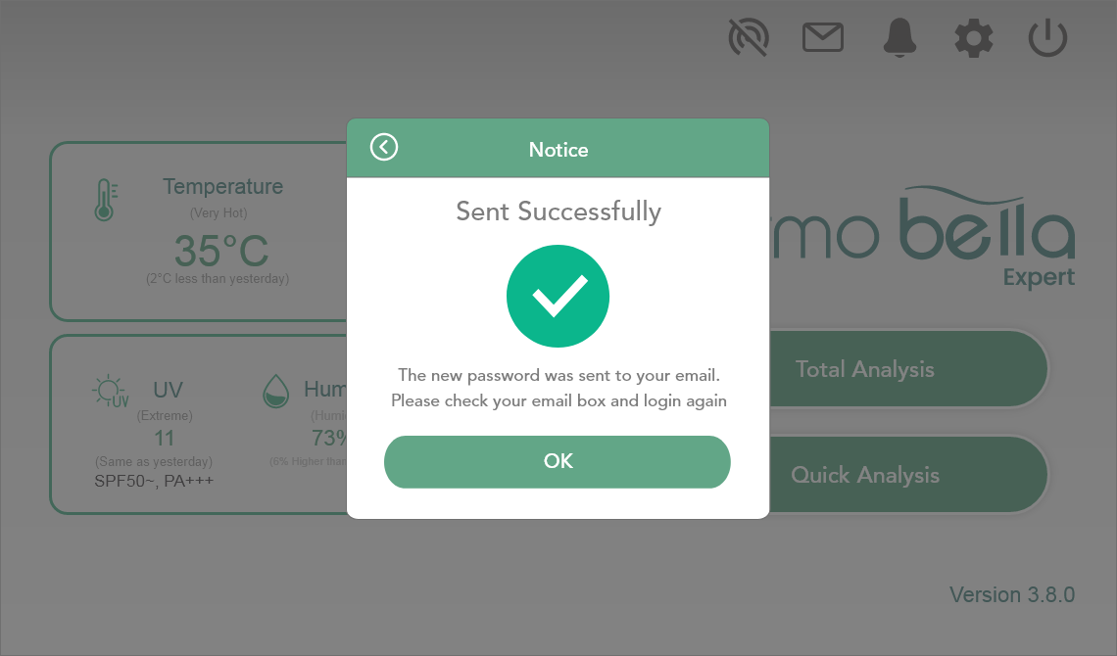
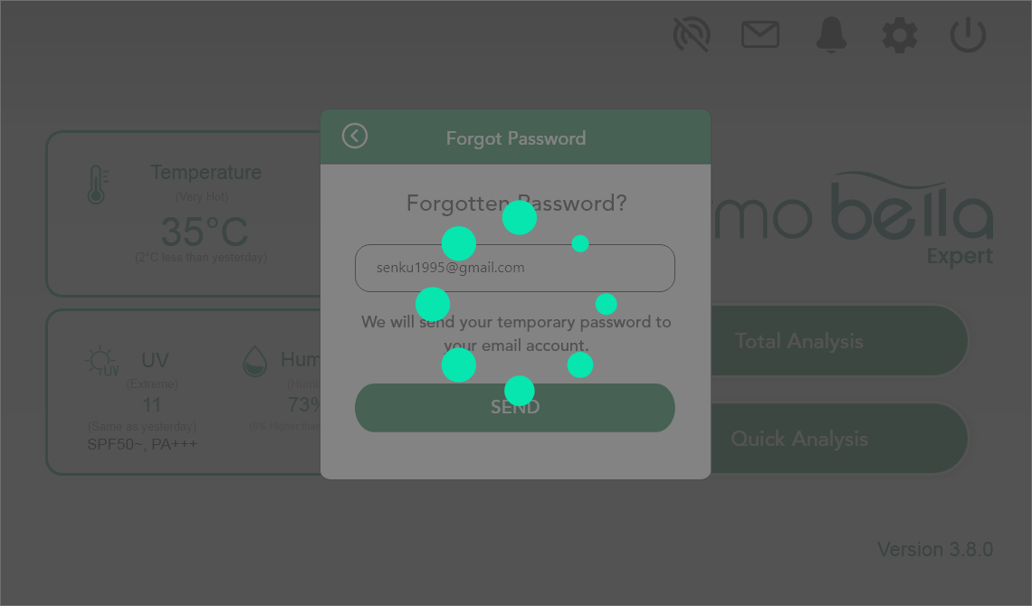
Reset Password

Slide 11
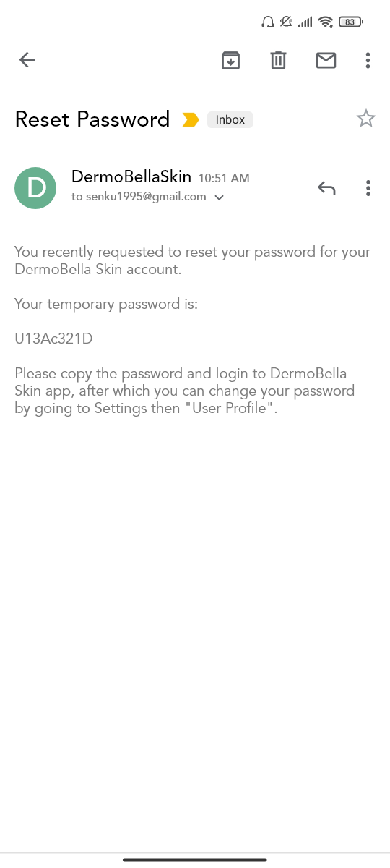

Slide 12
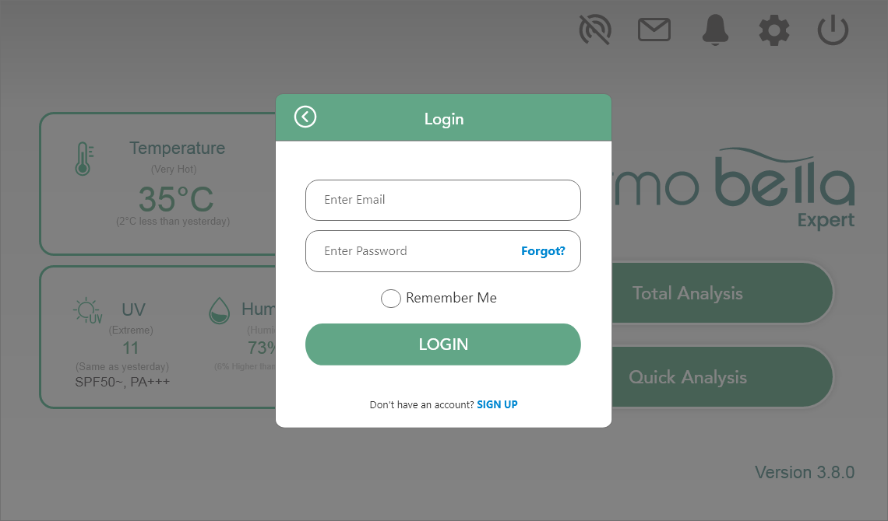
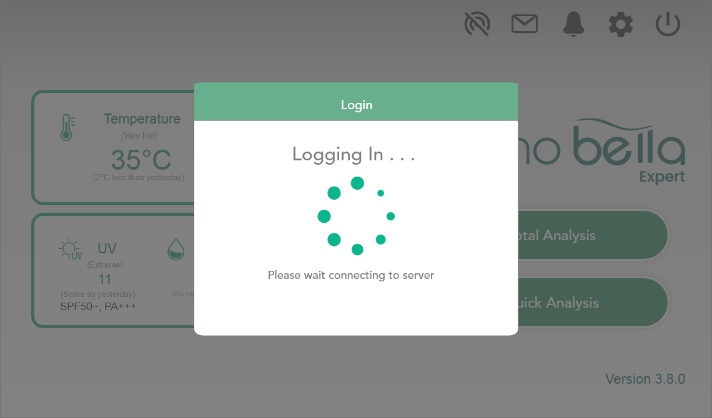
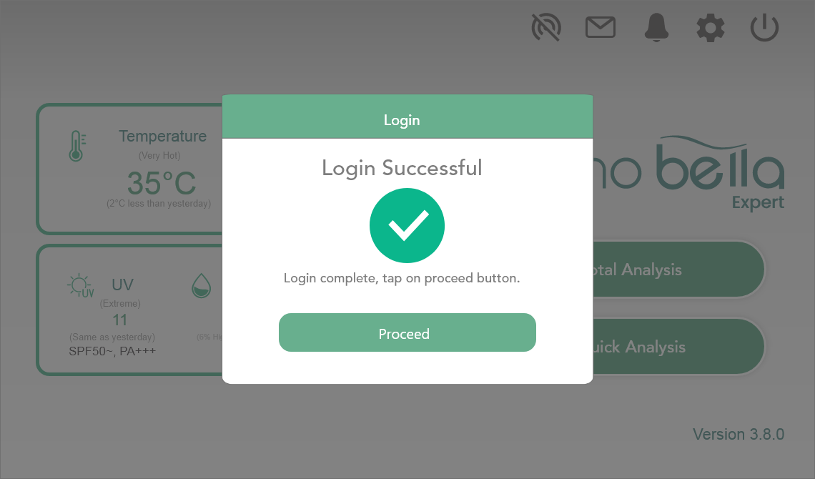
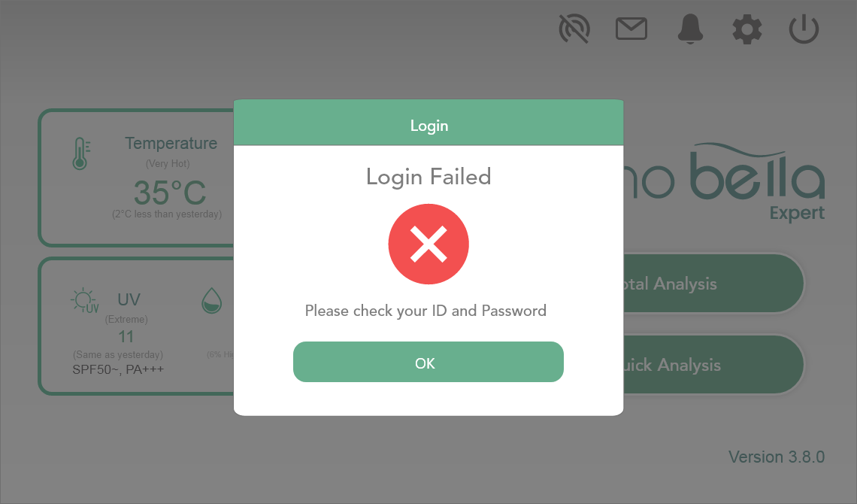
USER LOGIN
Next Slide

Slide 13
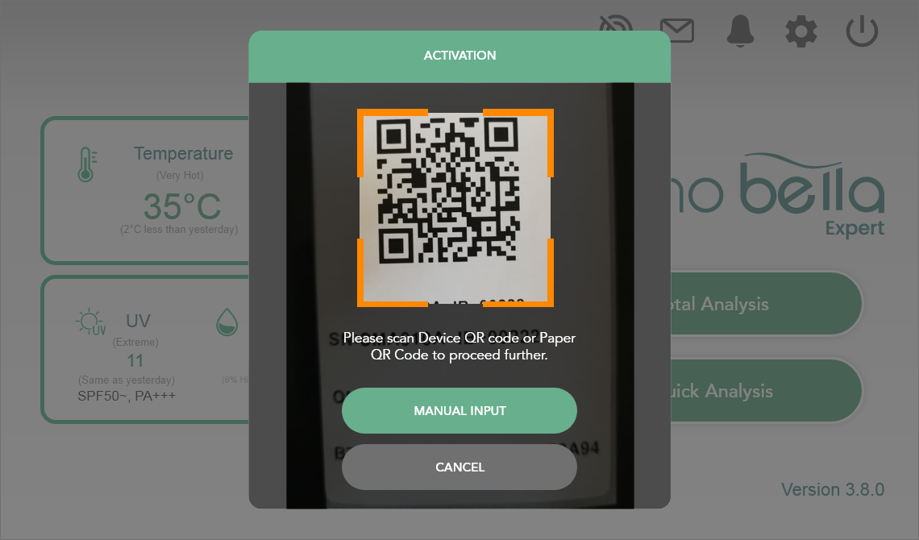
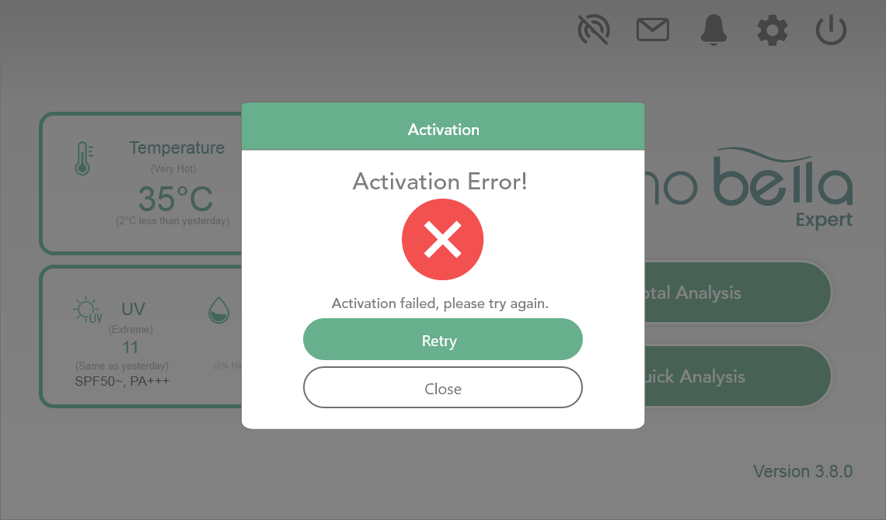
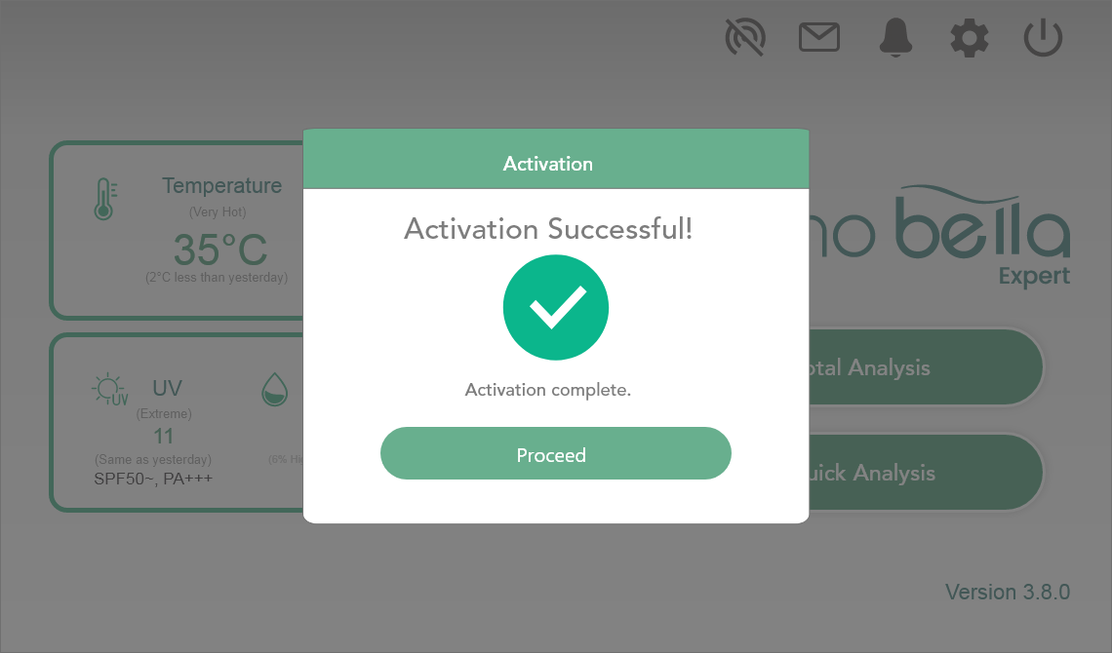
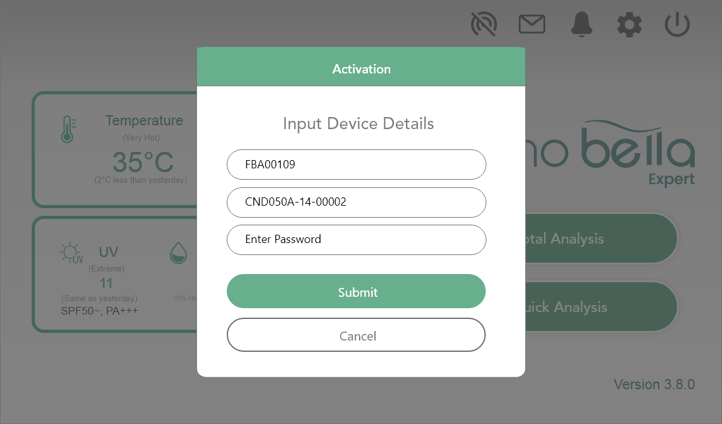

DEVICE ACTIVATION
Next Slide

Slide 14
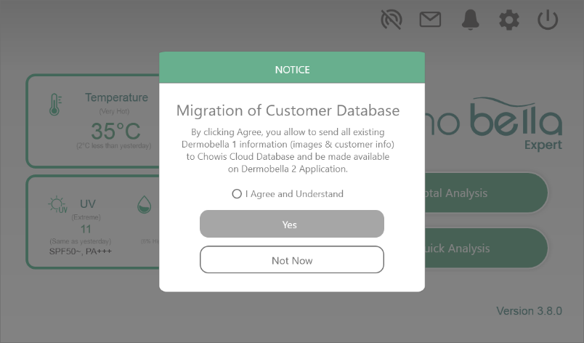
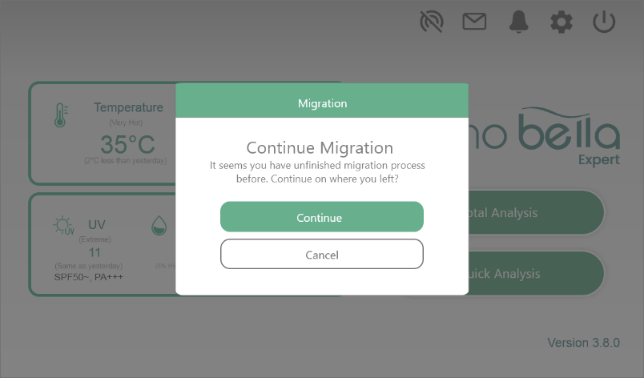
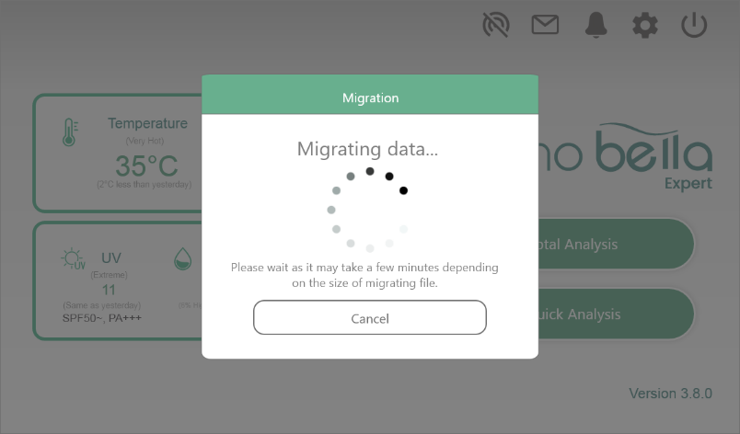
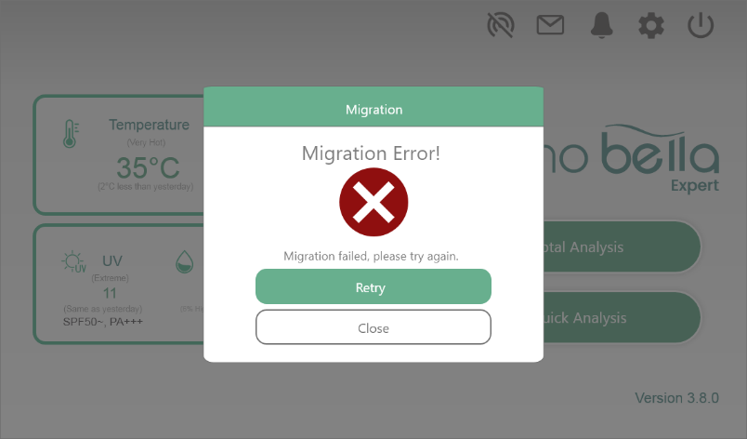
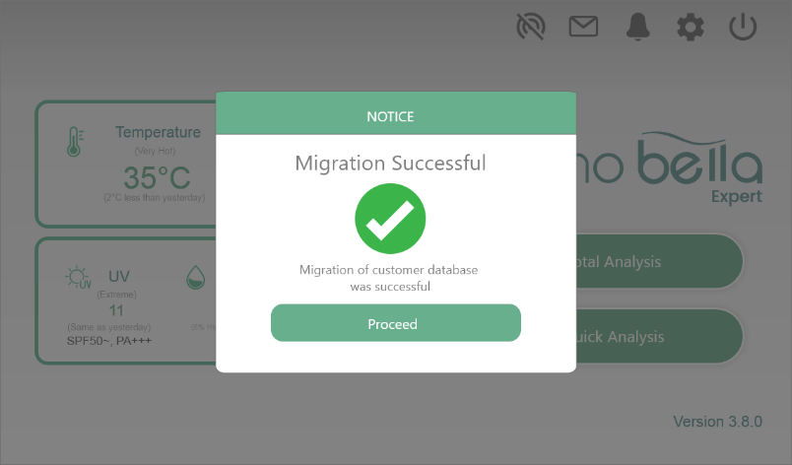

MIGRATION
Back to login page
Back to login page
Next Slide

Slide 15
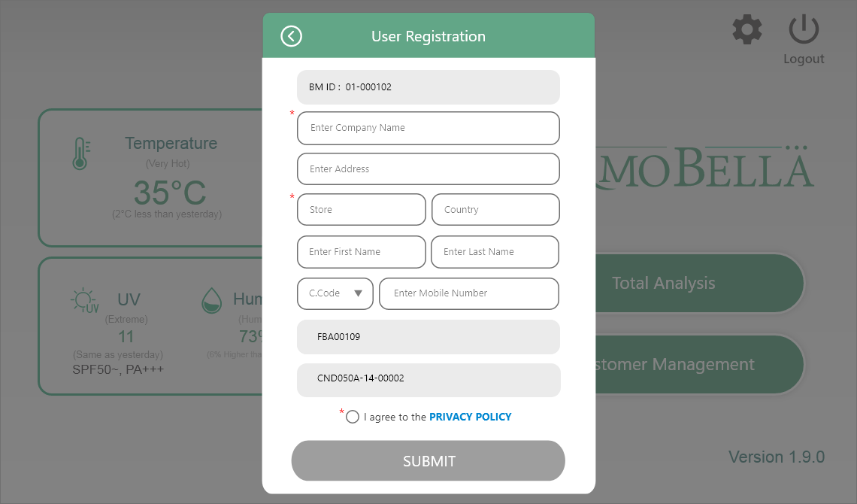
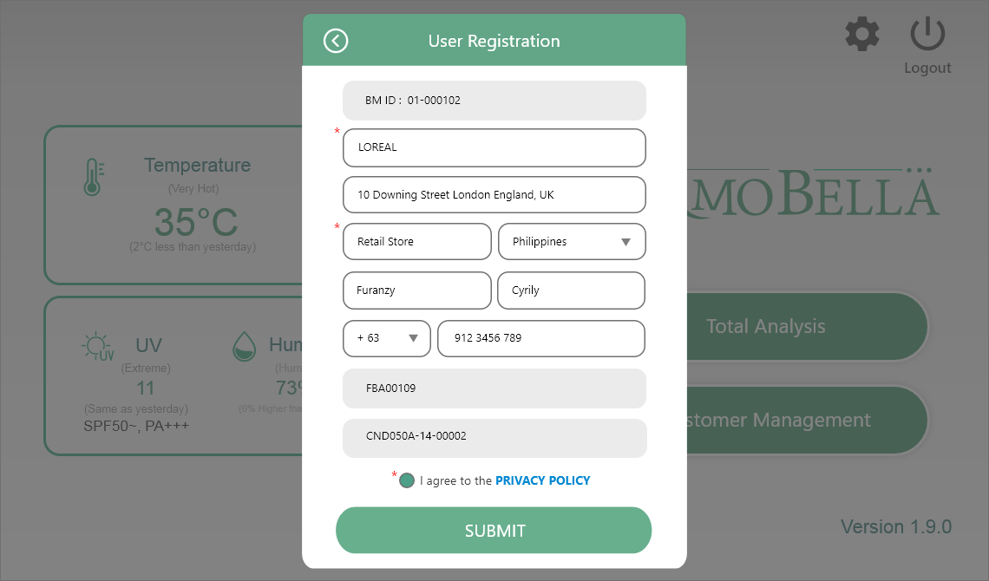
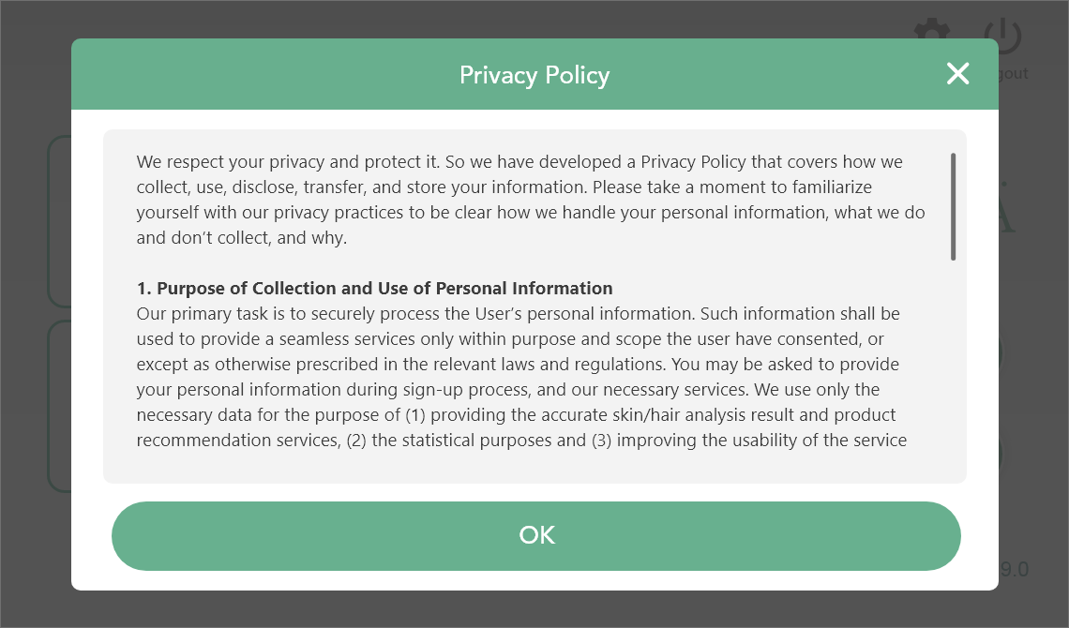
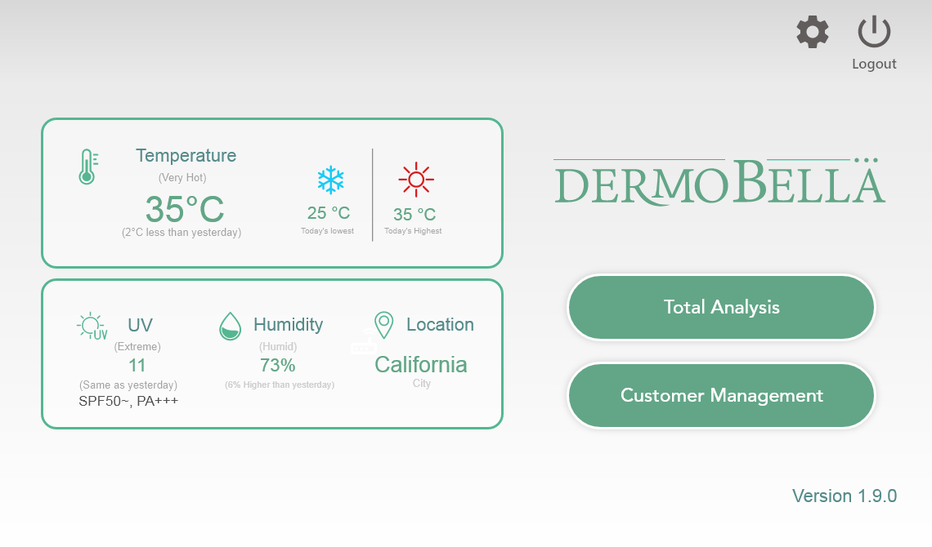
USER Registration

Slide 16
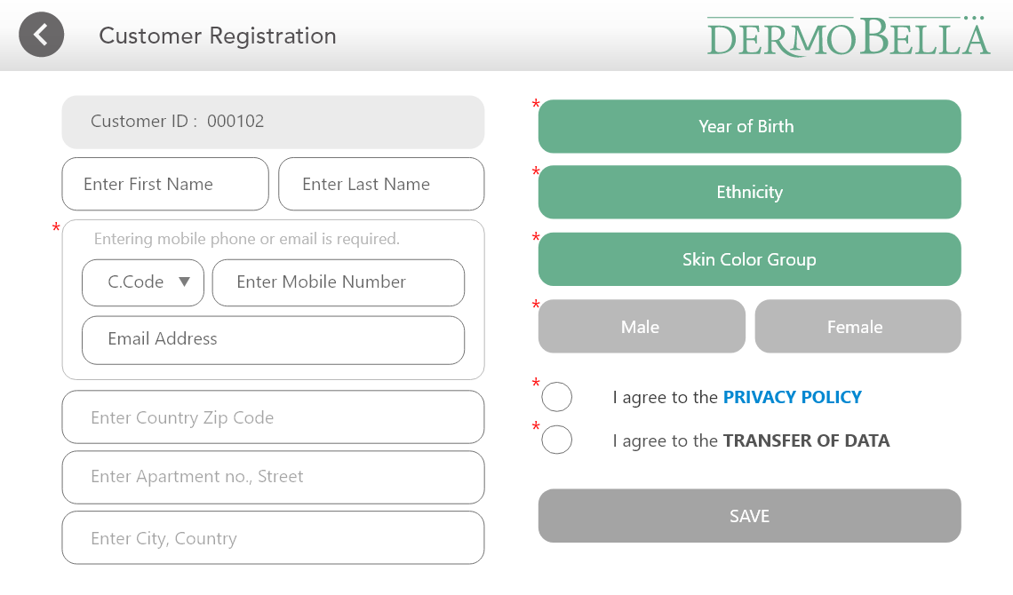
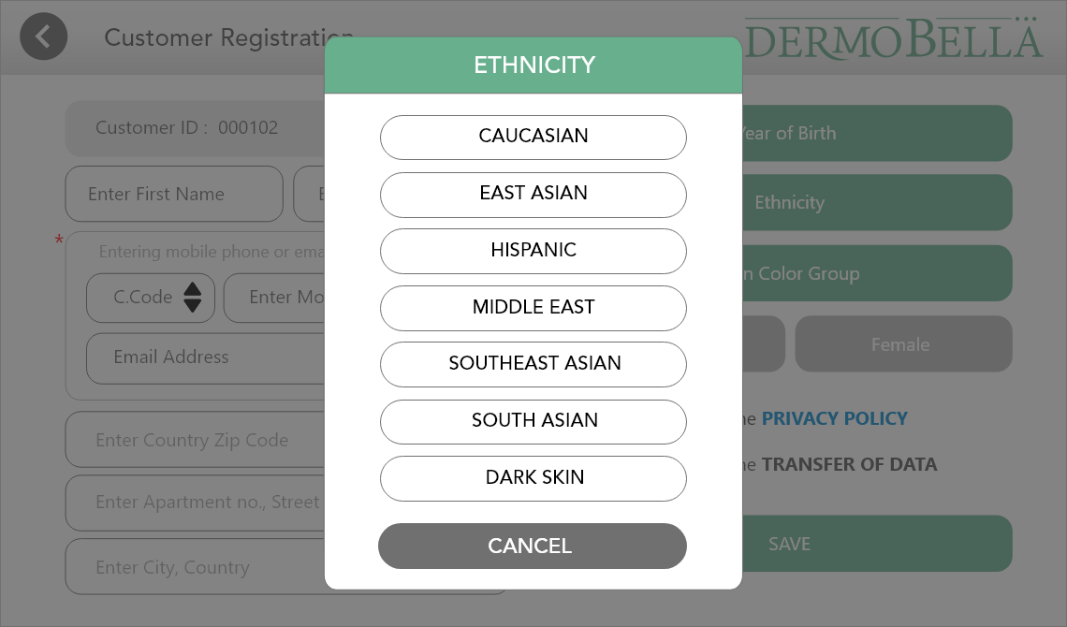
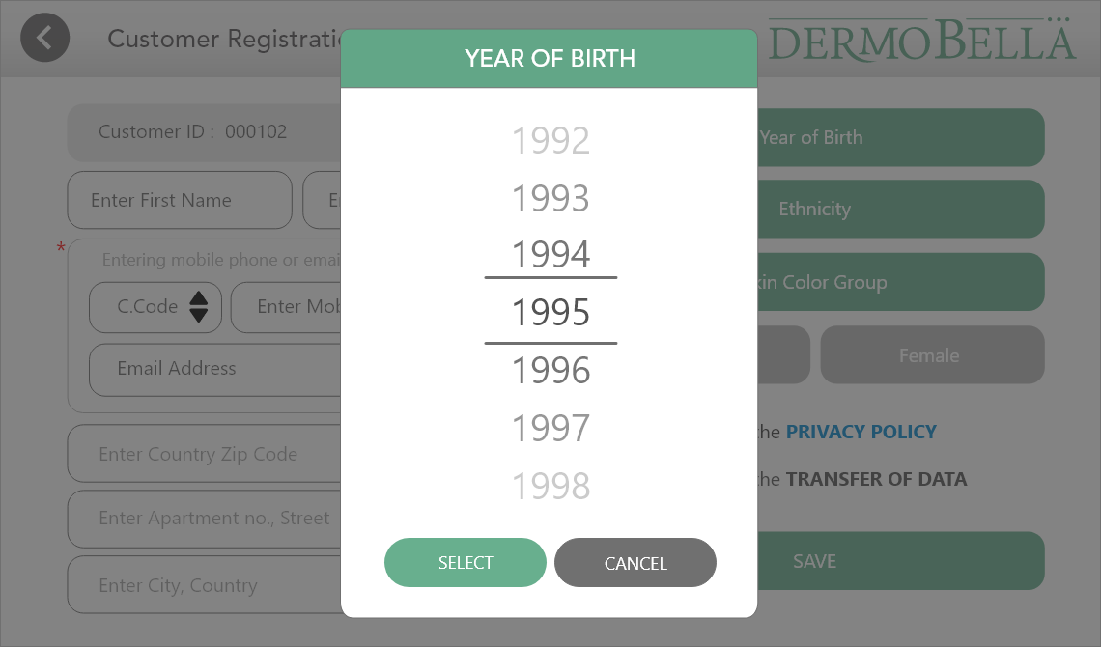
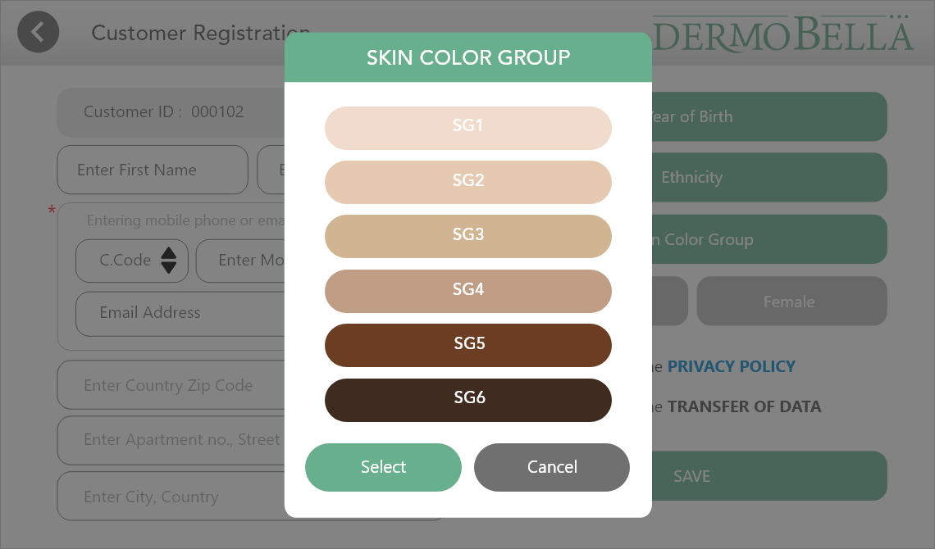
New Customer Registration

Slide 17
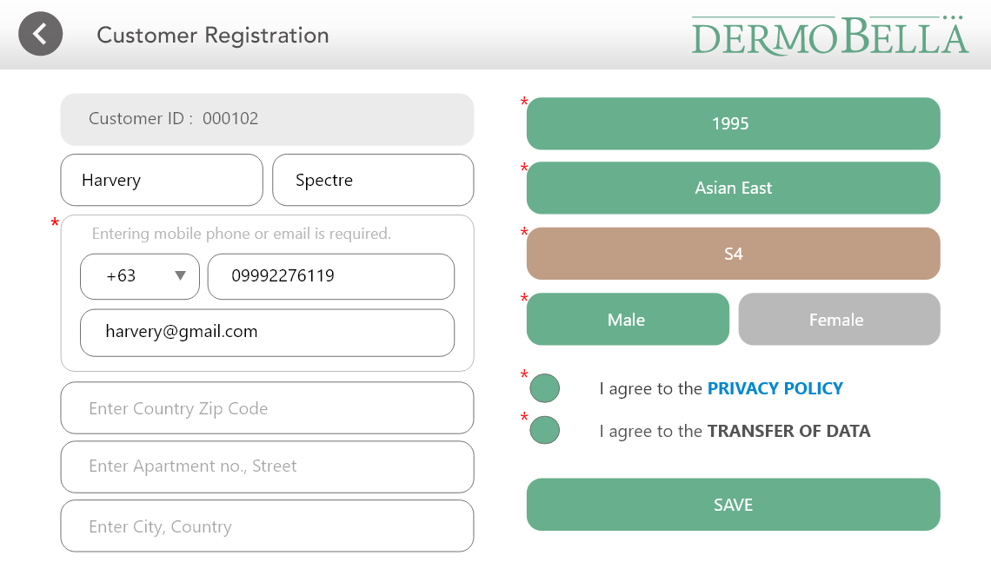
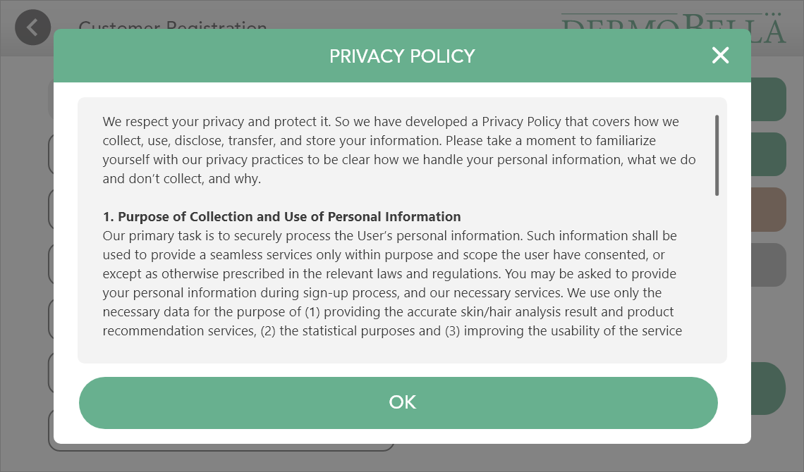
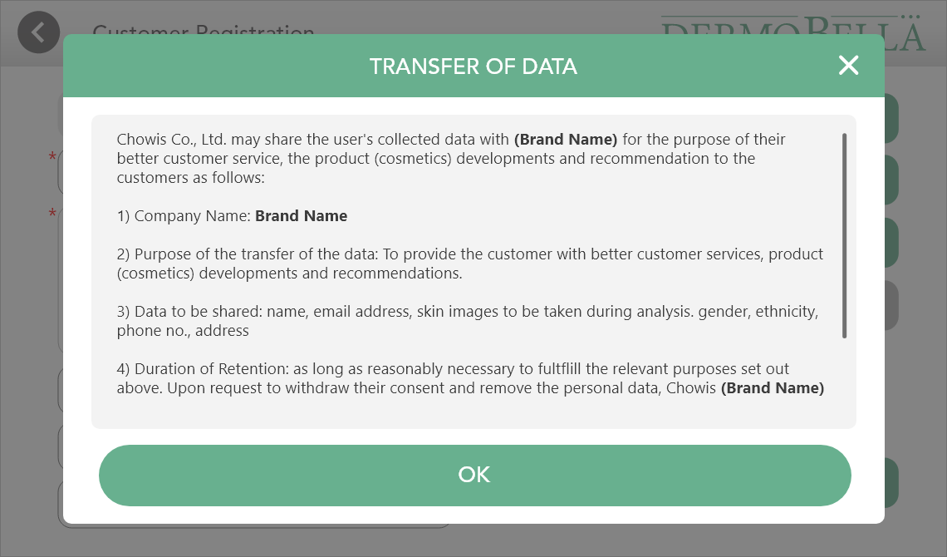
New Customer Registration – Privacy Policy & Transfer of Data
Brand Name under the TRANSFER of DATA under End-user registration will be
always changing based on the company name under the BM USER PROFILE.
For example, if User registered in BM user profile company name as "Loreal" then,
under the end-user registration (slide) when I agree to the TRASNFER OF DATA,
“Brand Name" will be changed to "Loreal automatically“
“Optic Number = Brand Name”

Slide 18
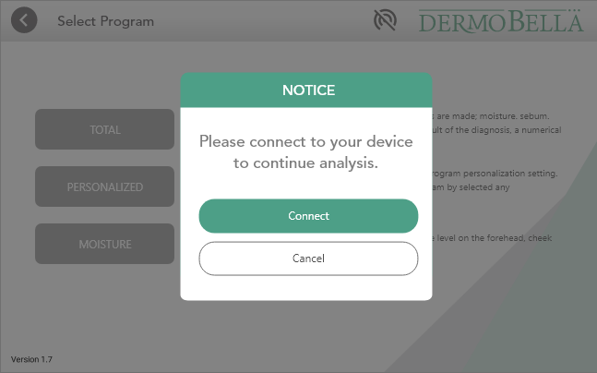
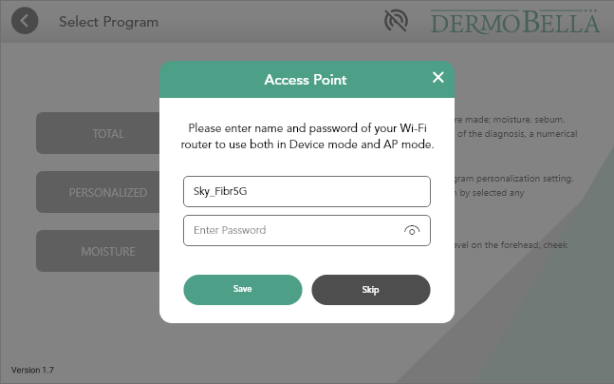
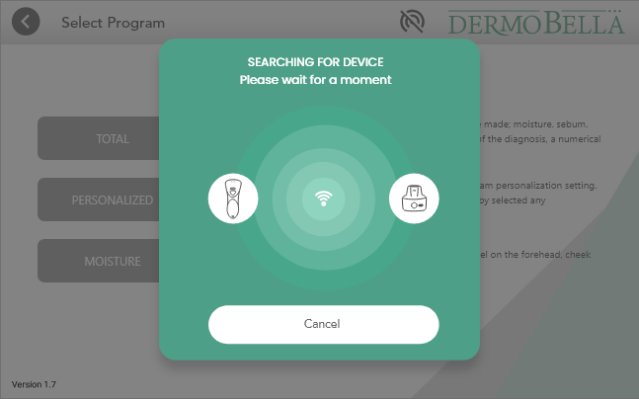
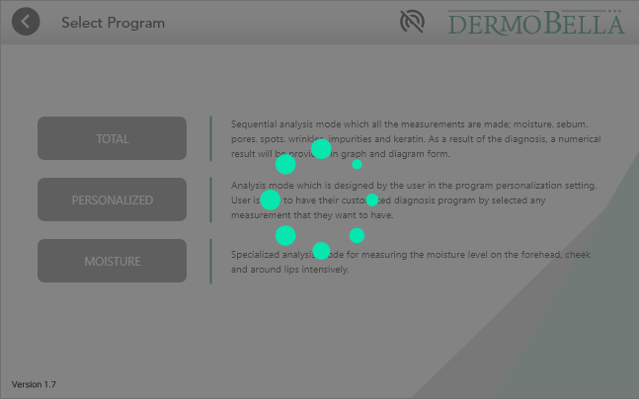
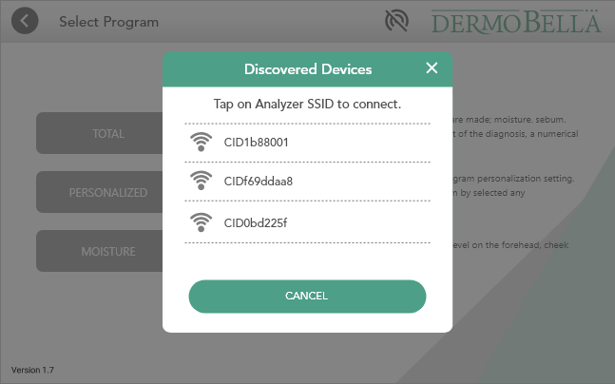
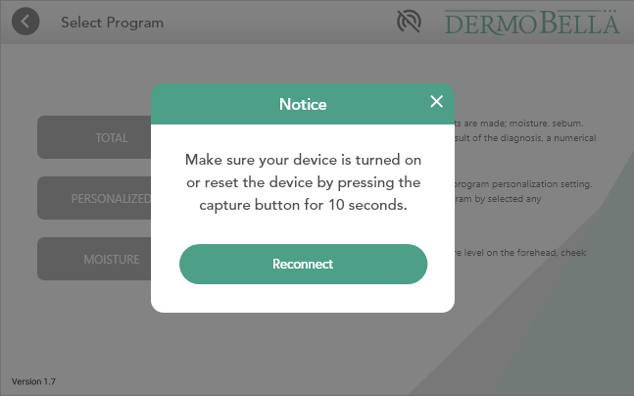
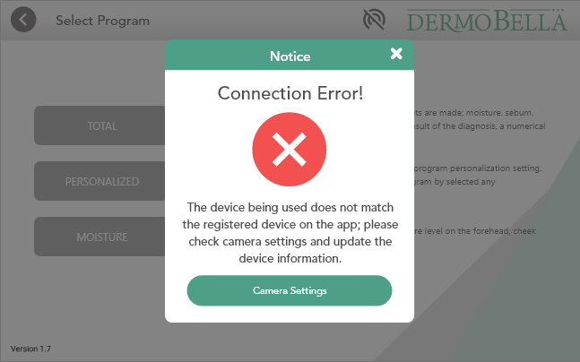
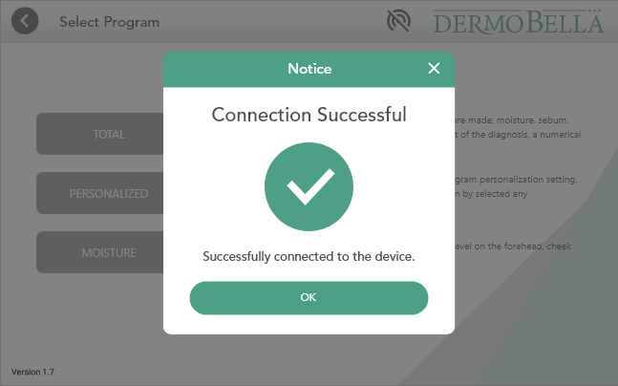

TOTAL ANALYSIS - DEVICE MODE
If no device detected
Next Slide
When users connect unregistered device

Slide 19







Slide 20





AP MODE
Next Slide

Slide 21




Quick Analysis
Next Slide

Slide 22
Total Analysis

Slide 23
FFA AUTO CAPTURE (Default)

Slide 24







FFA – Portrait Mode (Default)
Voice Over : Please do not move.
Auto capture
2 seconds to capture Voice Over : Two, one
Sound Effect : Capture Shutter
Switch camera front/back
Next Slide

Slide 25




FFA – Portrait Mode (Default)

Slide 26
FFA MANUAL CAPTURE

Slide 27






FFA– Portrait Mode (Default)
Manual capture
Voice Over : Please follow the guide and press the capture button.
Next Slide

Slide 28



FFA– Portrait Mode (Default)

Slide 29
FFA Auto – Landscape Mode

Slide 30





FFA – Landscape Mode (not recommended) for tablet users
- Landscape Mode can be enable as option on Settings => General Options
Note: No option of Landscape Mode for Mobile Phone Users.
Next Slide

Slide 31
FFA Manual – Landscape Mode

Slide 32



FFA – Landscape Mode (not recommended) for tablet users
- Landscape Mode can be enable as option on Settings => General Options
Note: No option of Landscape Mode for Mobile Phone Users.

Slide 33





Skin Health Questionnaire
Next Slide

Slide 34






Analysis
If device is disconnected
Failed to reconnect
Reconnected

Slide 35





Next Slide

Slide 36






Skin Tone with Makeup
CONFIDENTIAL Copyright © 2018 Chowis Co. Ltd.

Slide 37





Skin Tone without Makeup
CONFIDENTIAL Copyright © 2018 Chowis Co. Ltd.

Slide 38


Skin Tone without Makeup
Next Slide
NOTE: By pressing the NEXT button, this will send request and Send Images to server for First Analysis with Bath ID on cloud.
CONFIDENTIAL Copyright © 2018 Chowis Co. Ltd.

Slide 39






Skin Sensitivity Questionnaire
Next Slide

Slide 40


Analyze Taken Measurements
Next Slide
NOTE: By pressing Analyze button, it will get the Batch ID of the first Analysis then match with the Questionnaire result, combining and showing the Analysis Result.

Slide 41


Portrait View as default
Proceed to Analysis
Results Review

Slide 42



Slide 43



Slide 44



Slide 45
LANDSCAPE VIEW

Slide 46

Rotate View to Landscape

Slide 47

Proceed to Overall result

Slide 48


3D slide Animation
Rotation to next image

Slide 49


3D slide Animation
Rotation to next image

Slide 50



Slide 51




Analysis Results Review
Next Slide

Slide 52


Analysis Results Review
Next Slide

Slide 53





Results

Slide 54

Product Recommendation

Slide 55



Share Results – SNS

Slide 56

Share Results – Email
NOTE: As default, it will only send "URL" of Web Result. When option of analysis images, and recommended product is selected , we also attach there.

Slide 57




Slide 58



Share Results – KakaoTalk sample

Slide 59




Slide 60



CRM – Loads Local Data
Loads Local Data to CRM

Slide 61



CRM – Sync Analysis Record & Download Images
Loads data from cloud server, sync to local

Slide 62




Select Customer Manually downloads all that customer’s records
Or Select specific Analysis record

Slide 63

SELECTING DATE RANGE
Goes to next slide

Slide 64





Slide 65





Customer Management - History
Next Slide

Slide 66







Customer Management – Analyze
If no device detected

Slide 67







Settings

Slide 68





Settings – Skin Tone Product Recommendation
Default Password: ch7950
CONFIDENTIAL Copyright © 2018 Chowis Co. Ltd.

Slide 69





Settings – Skin Tone Product Recommendation
Default Password: ch7950
CONFIDENTIAL Copyright © 2018 Chowis Co. Ltd.

Slide 70







Settings

Slide 71



System Check
Next Slide

Slide 72




Slide 73



Device image display base on Optic Number – CND or CDP

Slide 74




Next Slide

Slide 75





Slide 76



